Slide 1
Scope of today’s work
Existence checks for testing whether a quantity really is a state function
Some background on why an existence check is important
Using the cross-integration method (CGI) to test for existence of a state function
Using the cross-derivative method (blackboard) test for existence

Slide 2
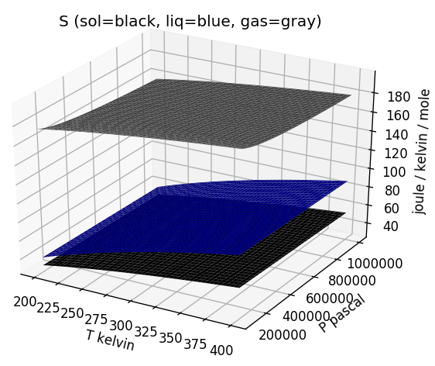
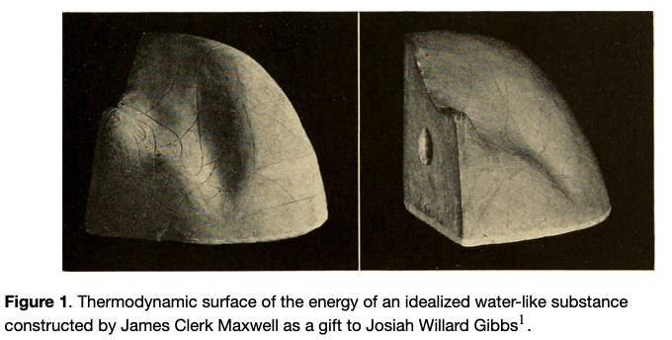
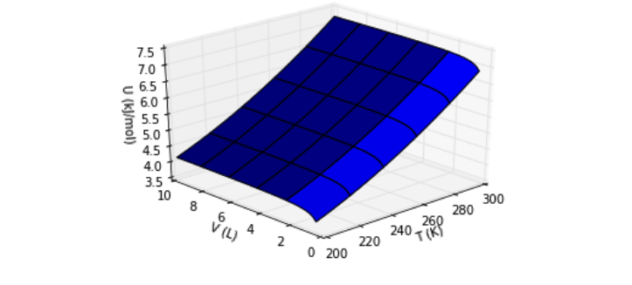

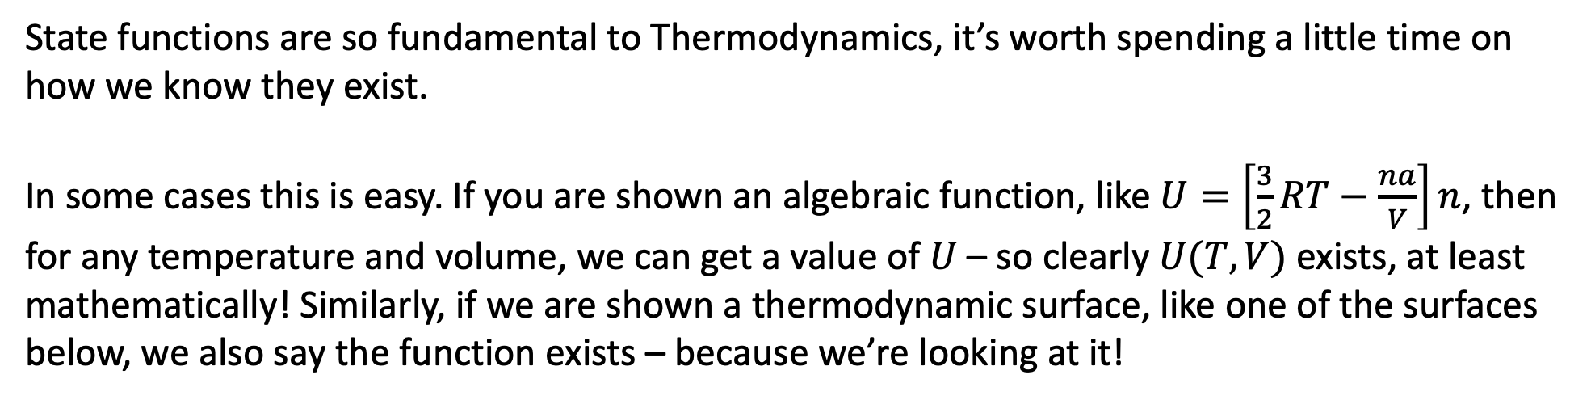

Existence check: Some background on why this is important
State functions are so fundamental to Thermodynamics, it’s worth spending a little time on how we know they exist.
In some cases this is easy. If you are shown an algebraic function, like $U=\left[\frac{3}{2}RT−\frac{na}{V}\right]n$, then for any temperature and volume, we can get a value of $U$ – so clearly $U(T,V)$ exists, at least mathematically! Similarly, if we are shown a thermodynamic surface, like one of the surfaces below, we also say the function exists – because we’re looking at it!
$$S(T,P)$$
$$U(T,V)$$

Slide 3

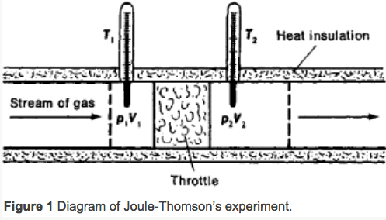
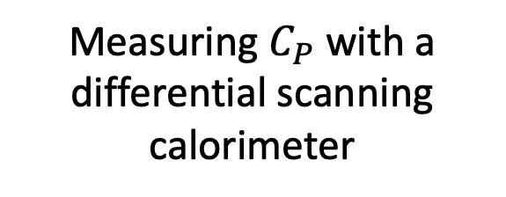
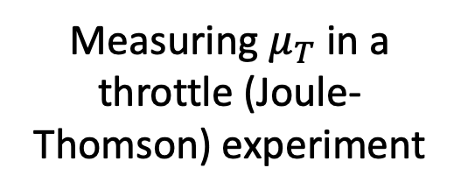
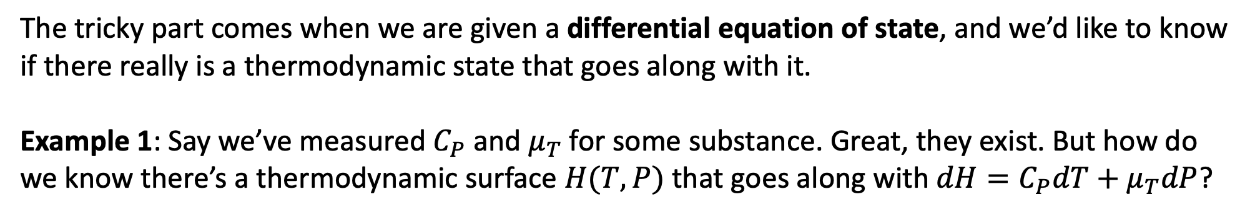
Existence check: How to tell whether a state function actually exists
The tricky part comes when we are given a differential equation of state, and we’d like to know if there really is a thermodynamic state that goes along with it.
Example 1: Say we’ve measured $C_{P}$and $μ_{T}$ for some substance. Great, they exist. But how do we know there’s a thermodynamic surface $H(T,P)$ that goes along with $dH=C_{P}dT+μ_{T}dP$?
Measuring $C_{P}$ with a differential scanning calorimeter
Measuring $μ_{T}$ in a throttle (Joule-Thomson) experiment
Example 2: Say we’ve measured $C_{P}$and $α_{P}$ for some substance. How do we know there’s a thermodynamic surface $S(T,P)$ that goes along with $dS=\frac{C_{P}}{T}dT−α_{P}VdP$?
Example 3: Say we’re told $dA=\frac{1}{T^{2}}dT+\frac{1}{TP}dP$. How do we know there’s a thermodynamic surface $A(T,P)$ that goes along with it? Fortunately, calculus gives us a couple of tools (next).

Slide 4
The cross-integration test for existence
Existence checks for testing whether a quantity really is a state function
Some background on why an existence check is important
Using the cross-integration method (CGI) to test for existence of a state function
Using the cross-derivative method (blackboard) test for existence

Slide 5
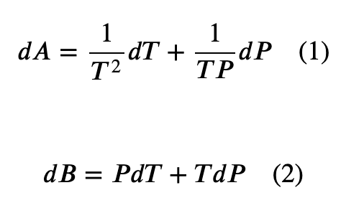
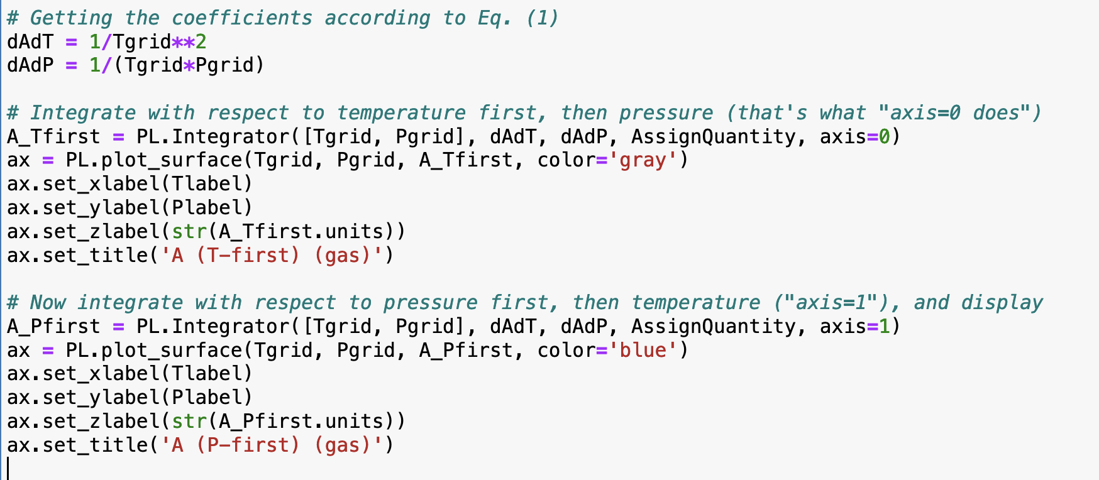
Numerical integration: PL.Integrator

Slide 6
Numerical integration: PL.Integrator

Slide 7
Numerical cross-integration: the Integrator

Slide 8
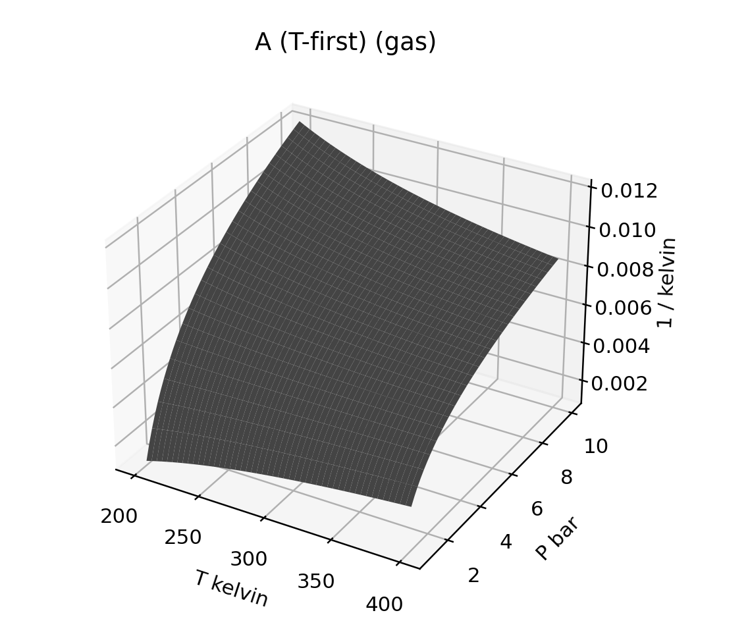
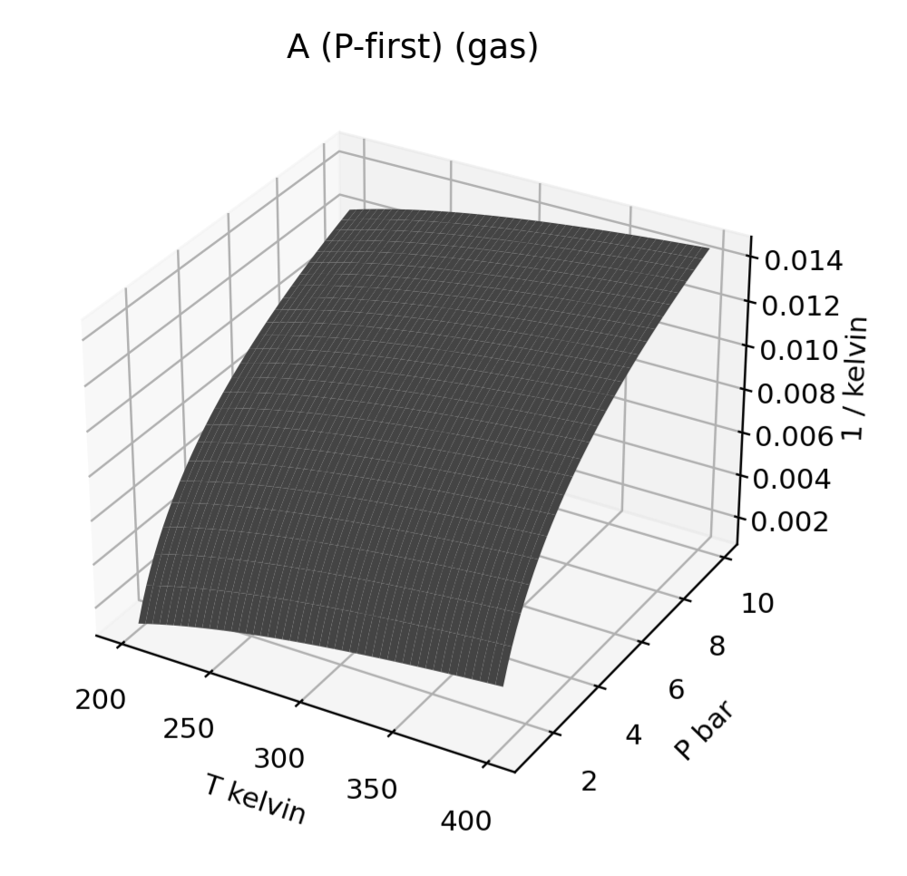
Numerical cross-integration: the Integrator

Slide 9
The CGI also has you test whether $B(T,P)$ exists

Slide 10
The cross-integration test for existence
Existence checks for testing whether a quantity really is a state function
Some background on why an existence check is important
Using the cross-integration method (CGI) to test for existence of a state function
Using the cross-derivative method (blackboard) test for existence

Slide 11
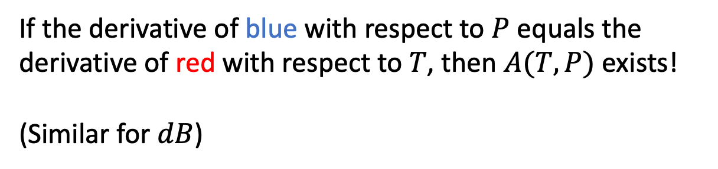
The cross-derivative test for existence
Existence checks for testing whether a quantity really is a state function
Some background on why an existence check is important
Using the cross-integration method (CGI) to test for existence of a state function
Using the cross-derivative method (blackboard) test for existence
If the derivative of blue with respect to $P$ equals the derivative of red with respect to $T$, then $A(T,P)$ exists!
(Similar for $dB$)

